Slide 1

The HL7 Project : FAIRness for FHIR
Develop the HL7 FHIR4FHIR IG
Provide guidance on supporting data FAIRness by using HL7 FHIR
Questa foto di Autore sconosciuto è concesso in licenza da CC BY

Slide 2
Assess the RW cases (RDA Indicators)
Describe how to implement with HL7 FHIR and where it provides added value
Provide implementation guidelines; FHIR conformance resources; examples
Check how the proposed solution fulfills the FAIR principles and indicators
Collect real-world cases involving collection of data
Healthcare datasets
Publication
Research studies
Others
Publication, discovery, retrieval
Notes:
I’d say that the first months, including the FAIR track have been used to better understand each other and in finding the right approach
At the end we came out with the idea of taking a set of well representative examples and to learn from them use them to provide guidance Provide guidance using concrete examples

Slide 3
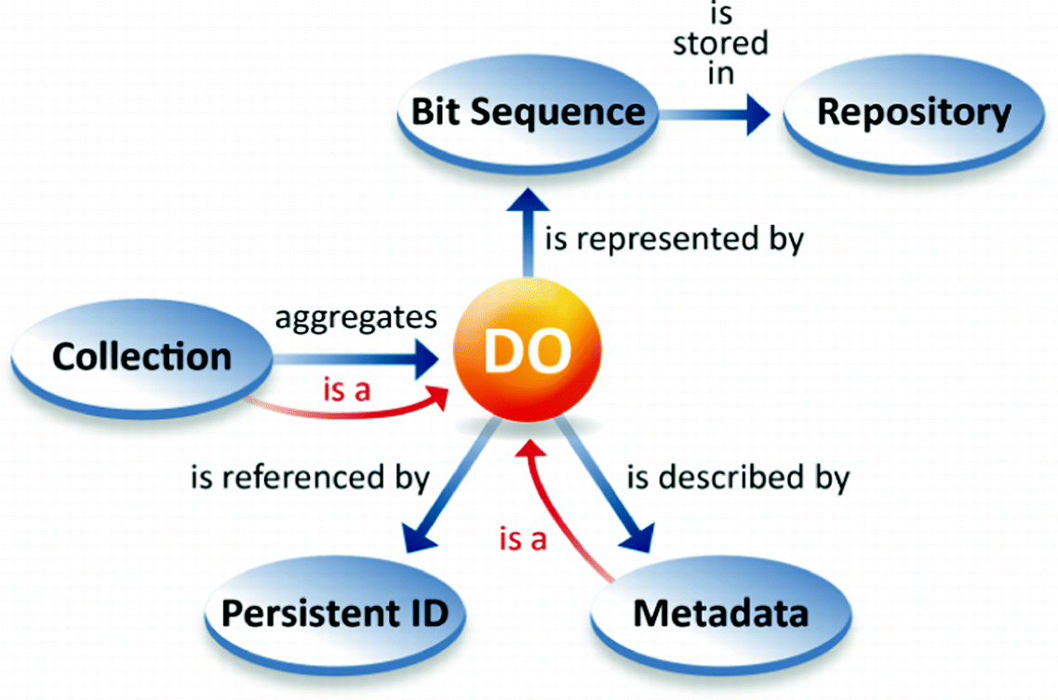
Linked Resources
Condition; Patient; ProviderRole; …
Resource
Condition
Element
Condition.Code
Element
Resource
Codeable Concept
1926006 | Osteopetrosis (disorder)

Slide 4
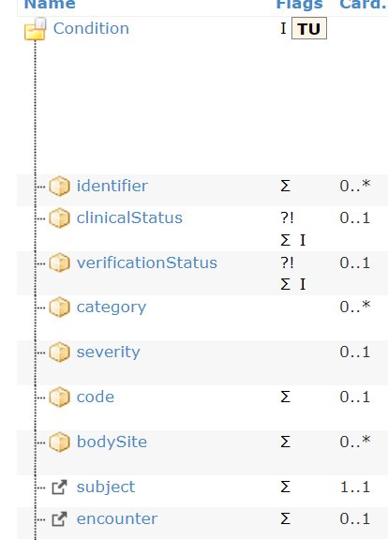
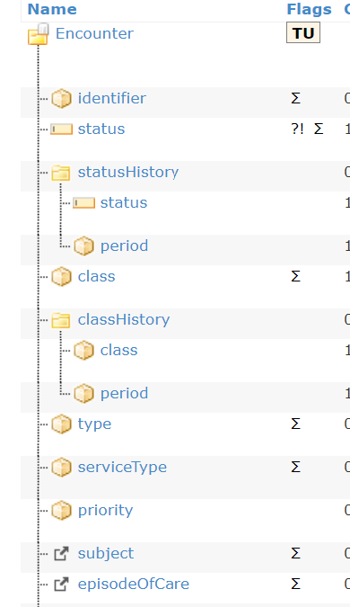
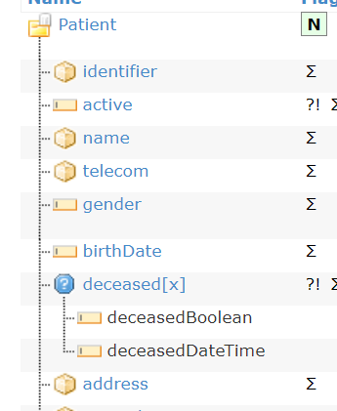
Data | Metadata
Diagnosis code | Verification status, Patient and Encounter data

Slide 5
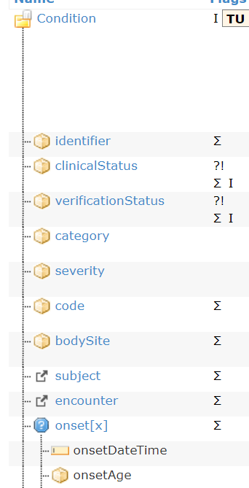
Implementing FAIR data with HL7 FHIR
Data | Metadata
Diagnosis, Patient Age | Patient

Slide 6
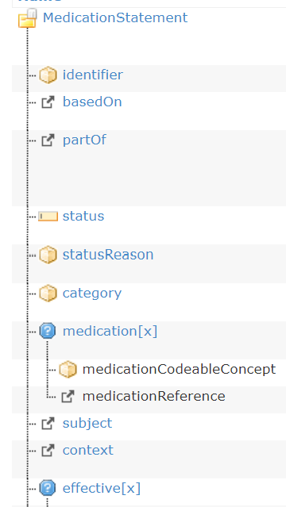
Data | Metadata
Diagnosis, Patient Age and Location, Medications taken, when | Patient data

Slide 7
Implementing FAIR data with HL7 FHIR
Data | Metadata
patient-related data | Purpose Owner Publication date Reference period
?

Slide 8
Fulfil data FAIRness maturity indicators
Suggest an assessment methodology

Slide 9
https://commons.wikimedia.org/wiki/user:SangyaPundir

Slide 10
Fulfil data FAIRness maturity indicators
Suggest an assessment methodology
Analyze relationship between FAIR data object conceptual components and FHIR resources
Analyze how RDA FAIR Maturity indicators and Reproducible Health Data Services recommendations are supported
Identify a minimum set of metadata to be fulfilled for specific sets of RDA FAIRness maturity indicators
Provide examples of best practices from EOSC (European Open Science Cloud) or NIH (National Institutes of Health).
Exploring machine readable and manual assessment methods.

Slide 11
Analyze relationship between FAIR data object conceptual components (e.g. data, metadata, provenance, identifiers) and HL7 FHIR resources
Analyze how RDA FAIR Maturity indicators are supported by specific HL7 FHIR resources
Analyze how RDA Reproducible Health Data Services recommendations can be supported by HL7 FHIR
Identify a minimum set of metadata to be fulfilled for specific sets of RDA FAIRness maturity indicators extended for health-related research data sets.
Provide examples of best practices from EOSC (European Open Science Cloud) or NIH (National Institutes of Health).

Slide 12
Exploring machine readable and manual assessment methods.

Slide 13
Identify how HL7 FHIR standard fulfils data FAIRness maturity indicators
Suggest an assessment methodology
Exploring machine readable and manual assessment methods.

Slide 14
HL7 FHIR4FHIR IG: SCOPE
Identify how HL7 FHIR standard fulfils data FAIRness maturity indicators
Analyze relationship between FAIR data object conceptual components (e.g. data, metadata, provenance, identifiers) and HL7 FHIR resources
Analyze how RDA FAIR Maturity indicators are supported by specific HL7 FHIR resources
Analyze how RDA Reproducible Health Data Services recommendations can be supported by HL7 FHIR
Identify a minimum set of metadata to be fulfilled for specific sets of RDA FAIRness maturity indicators extended for health-related research data sets.
Provide examples of best practices from EOSC (European Open Science Cloud) or NIH (National Institutes of Health).
Suggest an assessment methodology

Slide 15
HL7 FHIR4FAIR IG
Informative guidance
“FAIR and FHIR”
Conformance Rules
“Assessing data FAIRness”
Explaining for example how
FAIR principles can be supported by using HL7 FHIR;
Conceptual components of the FAIR data objects maps into FHIR;
Data FAIRness maturity indicators may be assessed by using FHIR;
Including a set of FHIR conformance resources and examples that provide, for selected case(s), a practical example of how FAIRness could be assessed.
Notes:
This IG will comprise a … +

Slide 16




HL7 FHIR4FHIR IG: a collaboration result

Slide 17

Time Plan
HL7
Project Scope Statement
Approval
Sept 2020
Oct 2020
Oct 2020
TSC Approval
Project Proposal Approved
Sponsor WG and FHIR MG Approved
STU Publication
May 2021
Oct 2021
STU IG
ballot
FAIR track @ FHIR Connectathon
Jan 2021
May 2021
Sep 2021
Jan 2022
…
Sep 2023
….
Normative Publication
May 2023
Oct 2023
Normative IG
ballot
Notes:
As described this is a Project Scope Statement
FAIR track @FHIR Connectathon

Slide 18
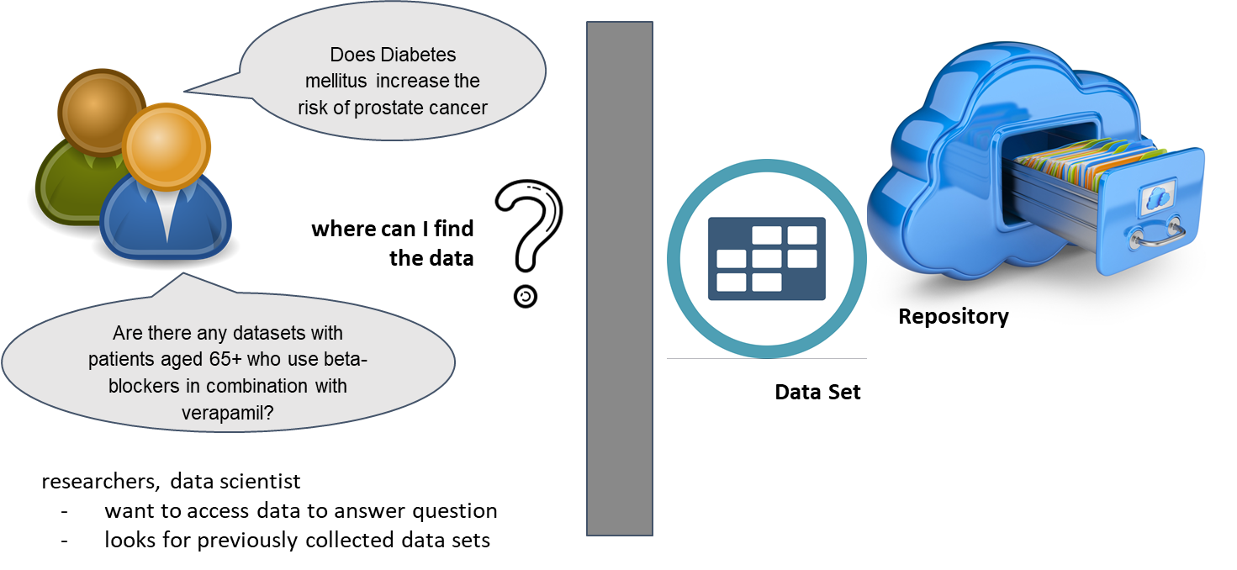
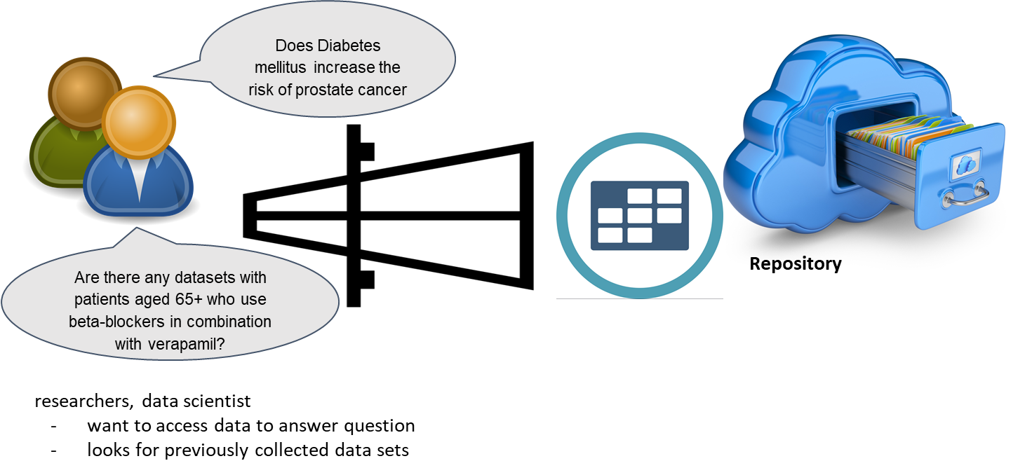


Slide 19

The journey has just begun…

Slide 20
… we have questions to be addressed …
What FHIR profiles are needed as mandatory measures of FAIRness?
How do we measure the FAIRness of an implementation?
What FAIR measures need to be included or are recommended in HL7 FHIR profiles and implementation guides?
…….

Slide 21
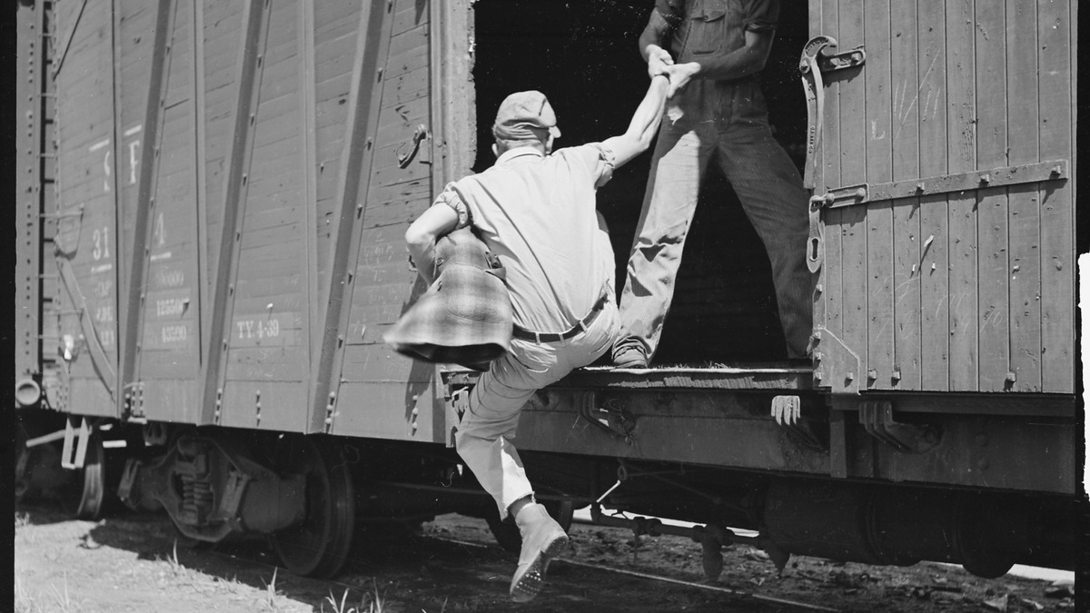
...it is The right time to jump in…

Slide 22

What If I’d like to ...
learn more about the project ?
get involved ?
participate to the FHIR connectathon ?
Is it complex ?
Is it only for developpers ?
Is it expensive ?

Slide 23
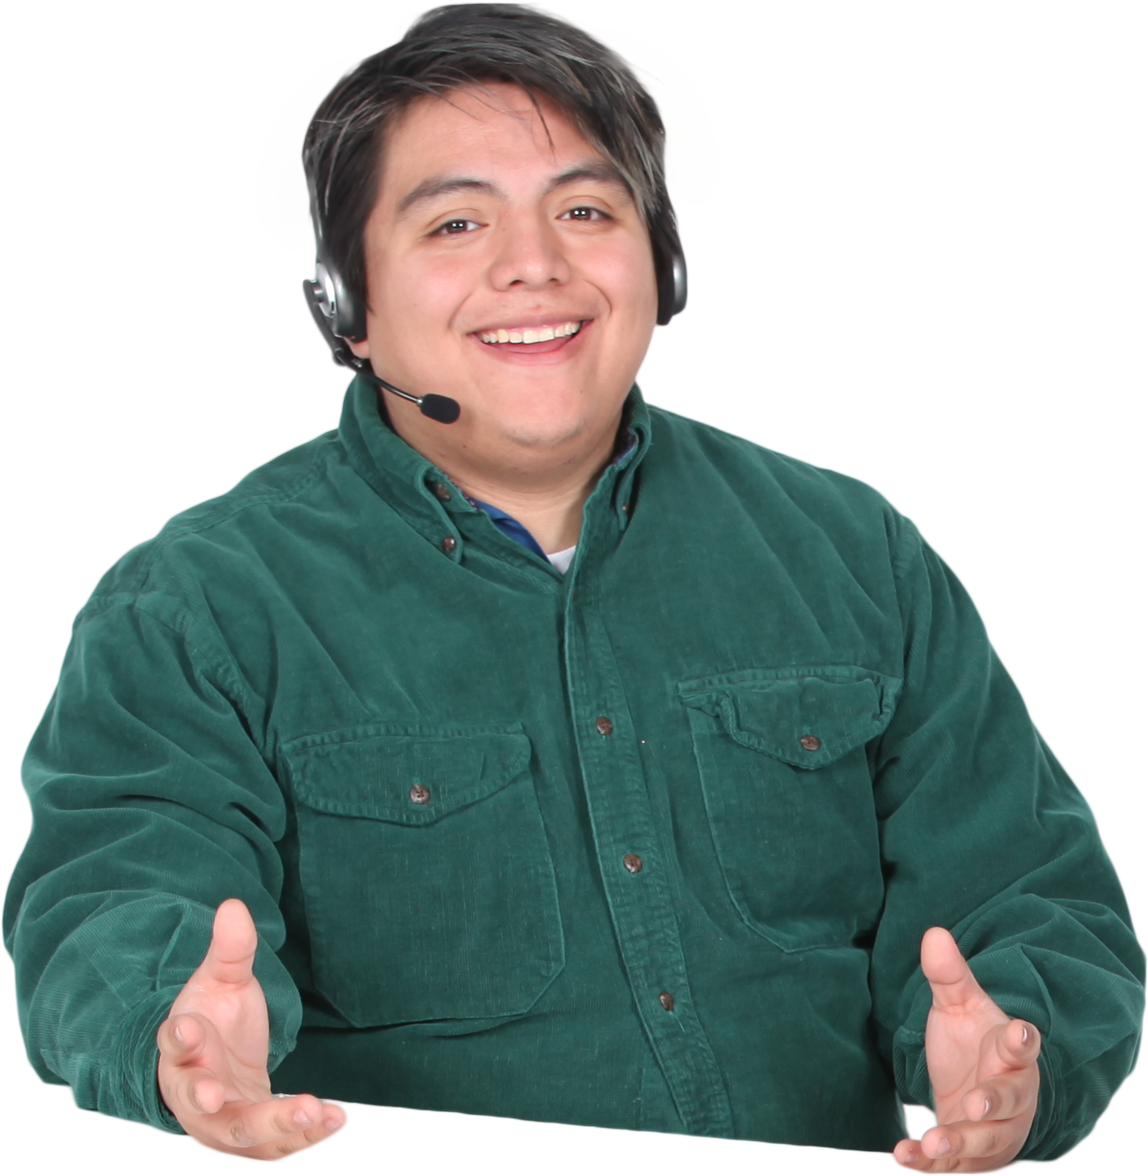
What If I’d like to ...
More infos about the project…
Confluence Project Page:
https://confluence.hl7.org/pages/viewpage.action?pageId=91991234
Get involved in the project or participate to the FHIR connectathon ?
Let’s talk about it…

